Slide 1
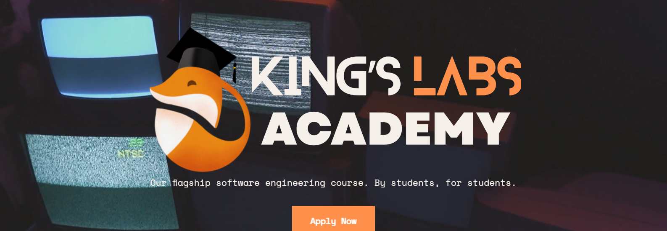

My time at
Omar Al-Mizan 08/03/2024

Slide 2
Where did I start?
Basic familiarity with HTML/CSS
Participated in a KCL WebDev hackathon (Got hard carried by my team)

Slide 3
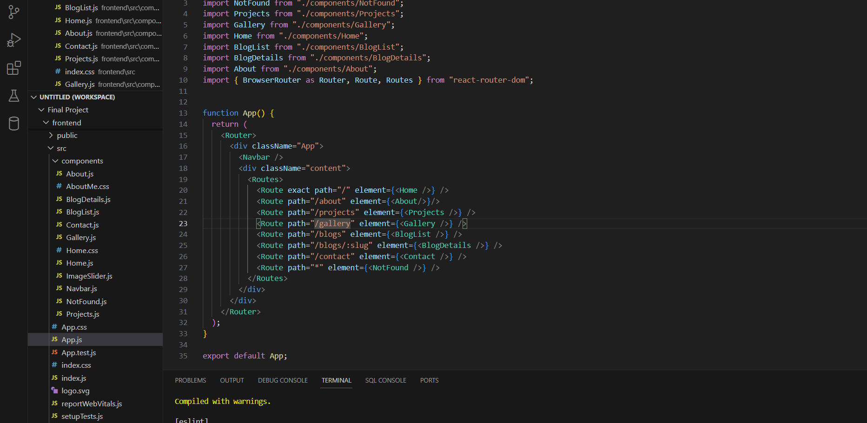
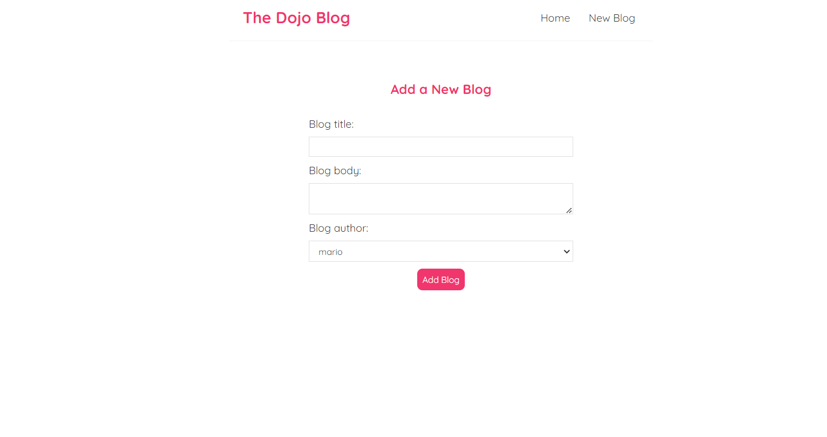
Frontend
I understand hooks now
React routing vs Fresh server HTML
Requests and JSON

Slide 4
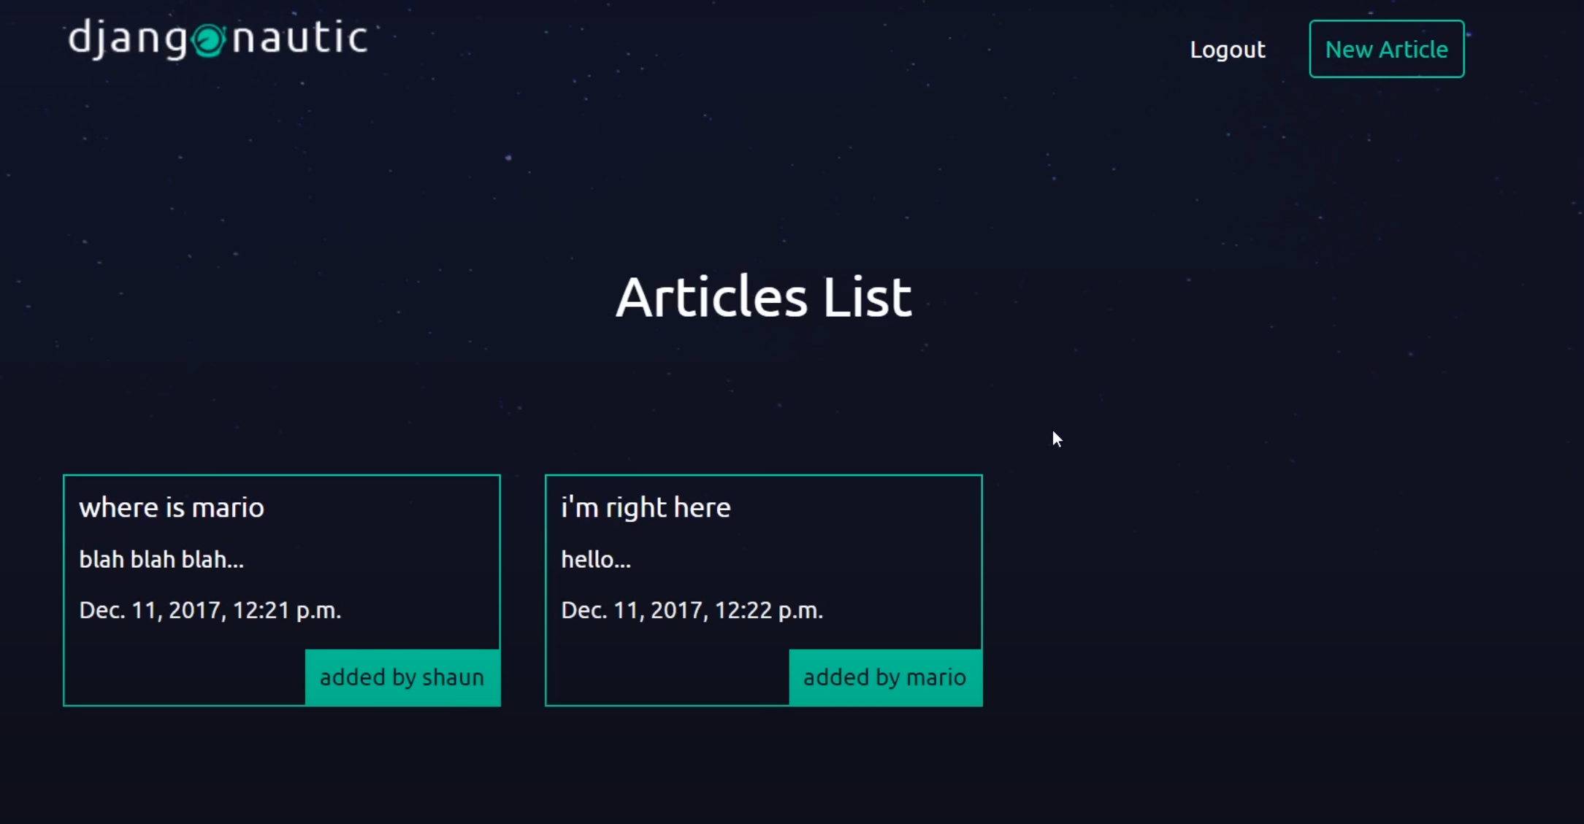
Backend
Practiced with a blog project
Django models and ORM vs SQL
Signal experimentation
FYH backend debacle

Slide 5
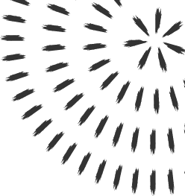

GIT
Version control practise during FYH
I have since uploaded all my worthwhile deeds to GitHub

Slide 6
Programming
Built Django Apps
Designed React Components (and a custom hook)
Imported them into the final project
Venv

Slide 7
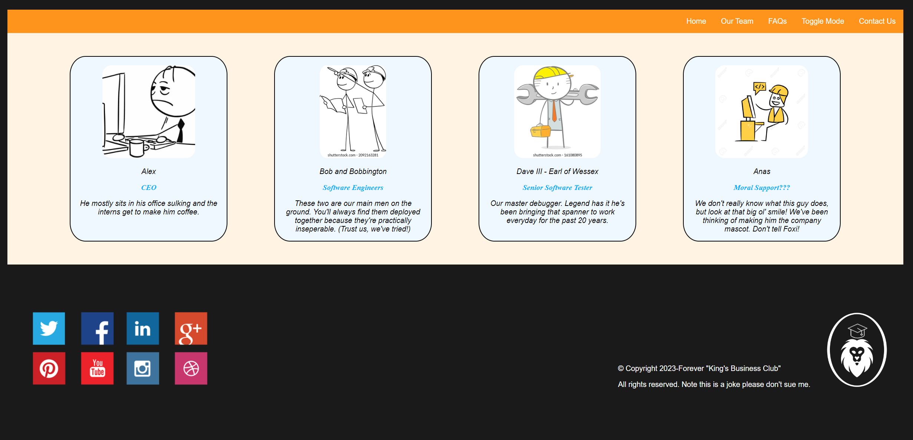
Project Reflection
I left it quite late, but the amount of practise stuff I’d done prior saved me.
Modularity is key!!!

Slide 8
What have I learned?
I am better at creating Models, Views and React Componetns than I am at UI design
My design sense is pretty poor, so I’ll need to work on that
I cannot use Figma to save my life
READ THE DOCS

Slide 9
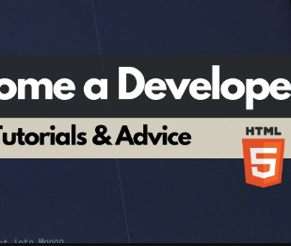

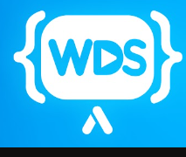
Acknowledgements
KLA
NET NINJA
WebDev Simplified How to Become a Developer
My mama for the moral support :)

Slide 10
Next steps:
Refactor my FYH project into react
Fix up my styles
Django Social Media Platform
Host my portfolio site.

Slide 11

Thanks for listening!

